Slide 1
Track indices using machine learning and deep learning methods
--- examplified on CSI 300
Team 9
Ziyuan Zhang
Zhitong Ye
Yang Xia
Weichen Zhu
Yingzi Li
12/7/2023

Slide 2
Index
Introduction
Methods
Benchmark Comparison
Conclusion

Slide 3
Introduction
Index tracking – 2 methods
Suppose history could repeat itself: mainly used &our choice
Incomplete replication :divide component securities into several sets and take different proportions
CSI 300
Compiled by China Securities Index Co., Ltd (CSI) since April 2005
A basic index of two Chinese capital market (Shanghai Stock market and Shenzhen Stock market)
Component chose based on liquidity and the market size, semi-annual adjustment every June and December
Contains over half of the total market capitalization → an overall reflection of the market trend
Cannot be directly traded and a full replication is infeasible in practice

Slide 4
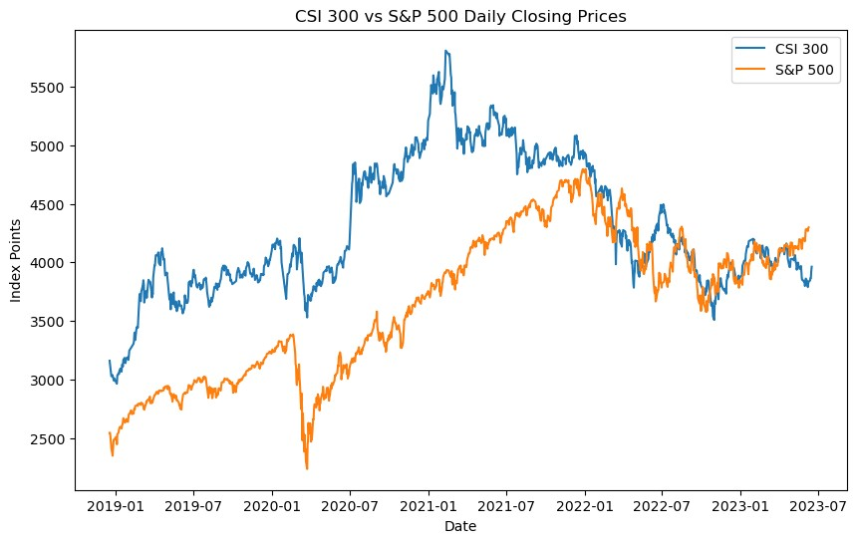
Introduction

Slide 5
Introduction
Data
Period: from 17 December 2018 to 12 June 2023
Source :Component stock price: China Securities Network(the statutory information disclosure media
The entry and exit records: WIND database.
Division: 7 Training periods: each includes a whole calendar year before a regular adjustment
7 Backtest periods: from the day after an adjustment to the day before next adjustment
What we do:
Every training period: minimize the tracking error between the portfolio and the index, get a totally new portfolio, ignoring related costs
Every back-test period: test the performance of the portfolio without further adjustment
Use 4 different classical methods including machine learning and deep learning techniques

Slide 6
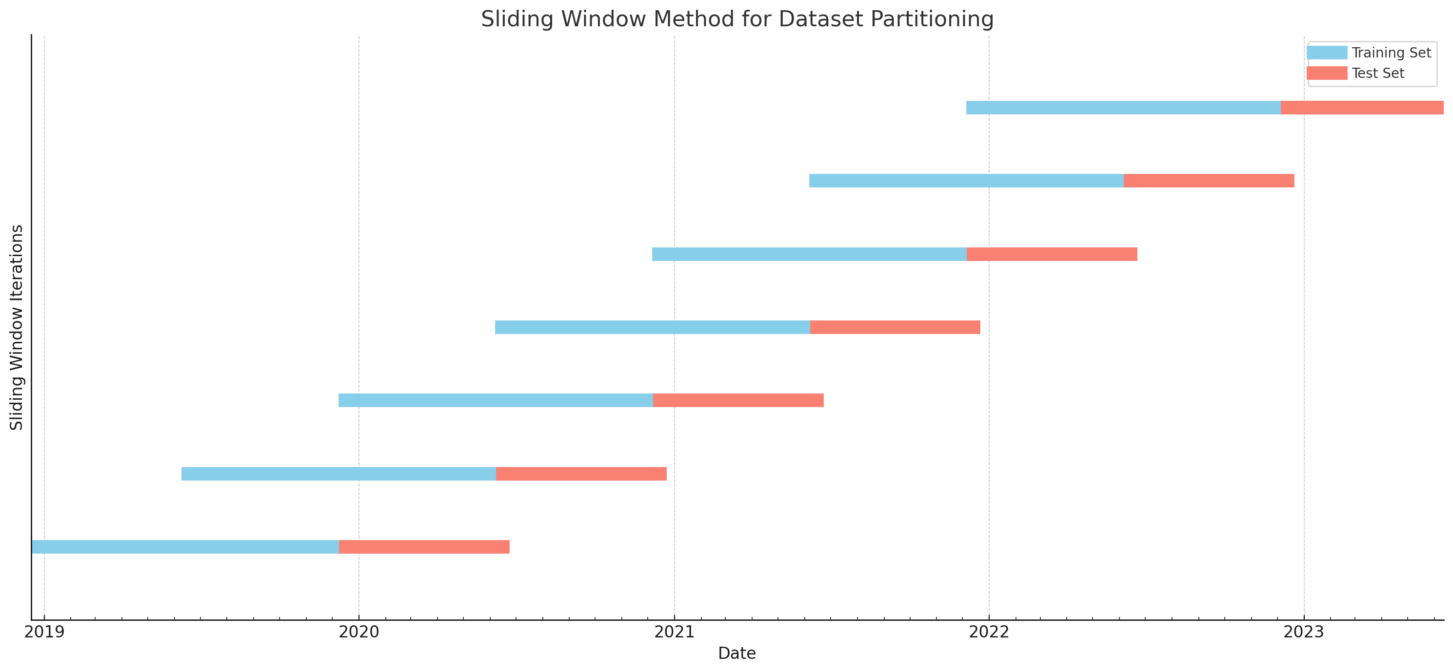
Time period division
Number | Training Period |  | Back-test Period
1 | 20181216 | 20191215 | 20191216 | 20200613
2 | 20190616 | 20200614 | 20200615 | 20201212
3 | 20191215 | 20201213 | 20201214 | 20210613
4 | 20200614 | 20210614 | 20210615 | 20211211
5 | 20201213 | 20211212 | 20211213 | 20220611
6 | 20210614 | 20220612 | 20220613 | 20221210
7 | 20211212 | 20221211 | 20221212 | 20230610

Slide 7
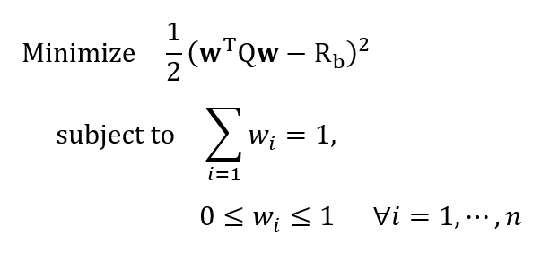
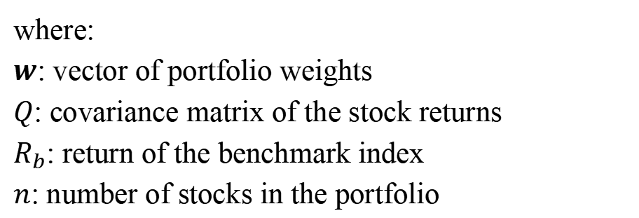
Method 1: Quadratic Programming model
Construct an optimization problem to minimize tracking error：
Constraints:
Sum of weights equals 1.
Each weight between 0 and 1 (no short selling allowed).
Setting: Assign equal weights to all stocks.
Solution Method: Sequential Least Squares Programming (SLSQP) .
where:
$w$: vector of portfolio weights
$Q$: covariance matrix of the stock returns
$R_{b}\text{:}$ return of the benchmark index
$n$: number of stocks in the portfolio
Notes:
"First off, we start with a Quadratic Programming model. This is all about setting up an optimization problem where our main goal is to minimize the tracking error. We've got some rules here - the sum of our stock weights has to equal 1, and each individual weight needs to be between 0 and 1, since short selling isn't part of our strategy. we give every stock an equal weight. To solve this, we use what's called Sequential Least Squares Programming, or SLSQP. It's a method used for tackling problems with constraints. it operates in a step-by-step manner, systematically searching for a new and improved solution at each stage

Slide 8
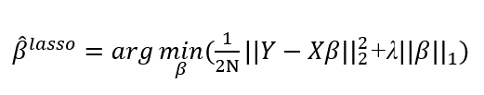
Method 2: Lasso Regression model
Select Top Stocks: Choose the 30 stocks with the highest weights from the Lasso model.
Normalization: Normalize these weights to sum up to 1.
where:
𝑌: the dependent variable
𝑋: matrix of independent variables
β: vector of coefficients
N: number of observations
λ: regularization parameter controlling the strength of the penalty
Advantage of Lasso regression:
Addresses Multicollinearity
Efficient Variable Selection
Flexible Variable Space
Reference: “Income replication strategy based on Lasso regression method”
Notes:
the second model is LASSO regression, compared with Ordinary Linear Regression, it adda an L1 penalty to the regression coefficients. so some variables' coefficients are easily shrunk to zero. This helps us in finding the best set of variables . lasso it's really effective in solving problems like multicollinearity and overfitting..
the mathematical model can be expressed as [your mathematical expression here].
So, our approach is to first pick the top thirty stocks based on their weights from the LASSO regression results, then normalize these to get our final set of weights."

Slide 9
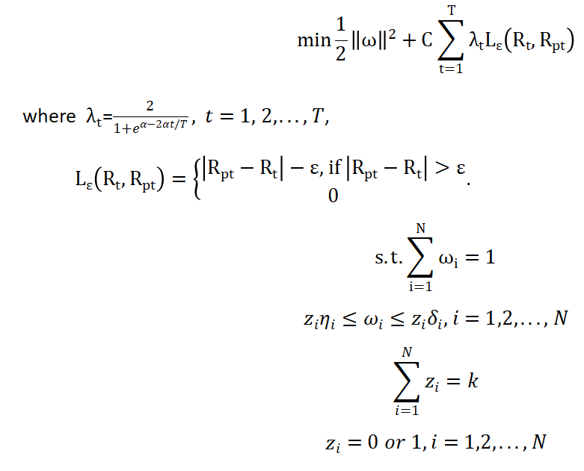
Method 3: A hybrid approach+A time-weighted SVR model
Select the stocks
Method:
A hybrid approach
A genetic algorithm+quadratic optimization
Pros:
The computational cost is relatively low
Re-optimize the weights of the selected stocks
Method:
A time-weighted SVR model
‘SVR’ (A linear regression method based on SVM)
‘Time-weighted’
Pros:
Avoid the overfitting problem
Considering the characteristics of financial data
Reference: “A stock index replicating model based on time weighted SVM and it’s empirical analysis”
Notes:
Let’s turn to the next model. This model is based on the paper ‘A stock index replicating model based on time weighted SVM and it’s empirical analysis’.
Firstly, we use a hybrid approach, which combines a genetic algorithm with quadratic optimization to select the stocks. Simply put, when selecting the optimal portfolio, we use a method called genetic algorithm. This algorithm judges the quality of each portfolio by examining their quadratic optimization effects. This hybrid method can help us find the almost optimal tracking portfolio, and the computational cost is also relatively low.
Secondly, we use a time-weighted SVR model to re-optimize the weights of the selected stocks. SVR is a linear regression method based on SVM. It sets a small epsilon. If the deviation between the return of the tracking portfolio and the return of the target index does not exceed epsilon, we do not believe that the tracking portfolio deviates from the target index, meaning that the error is negligible. This can help avoid the overfitting problem. Time-weighted means giving recent data greater weight. This is because financial data sequences are unstable and have high noise, and data closer to the present has a stronger impact on the future, providing more information.
And finally, we get the following objective function.

Slide 10
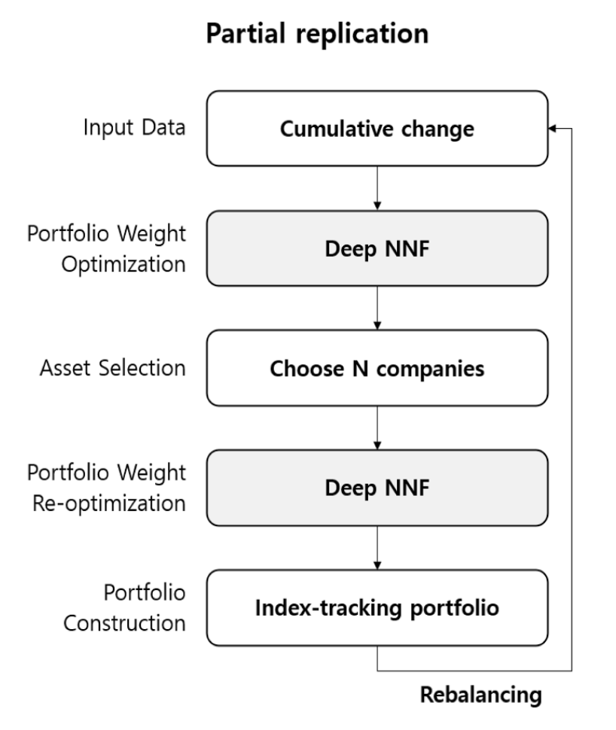
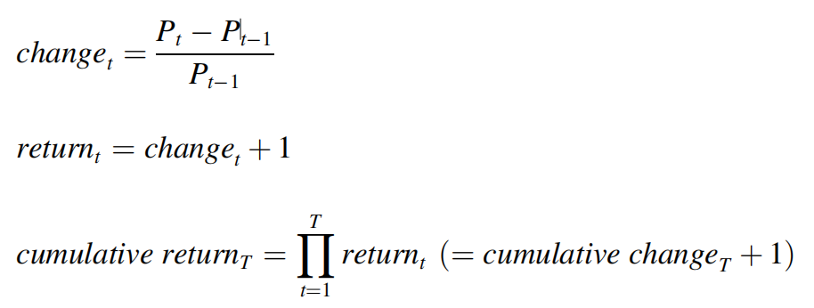
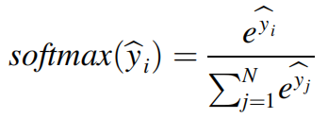
Method 4: NNF（Neural Network with Fixed noise） Optimization Method
Calculate the cumulative change
where P_t is the close price at time t and T is the total duration. For full replication, N is the total number of stocks in the benchmark index, and for partial replication, N is the number of stocks to include in the portfolio.
Use output of softmax layer as the portfolio weight of each stock:
N is the size of the softmax layer, and ̂y_i is the i th output value of the previous layer of the softmax layer.
Reference: “Neural network with fixed noise for index-tracking portfolio optimization”

Slide 11
Method 4: NNF（Neural Network with Fixed noise） Optimization Method
Results:
periods | methods | Tracking Error | Market Beta | Annualized Volatility | Max Drawdown | Sharpe Ratio | Sortino Ratio | Cumulative Return
20191217 - 20200616 | NNF | 0.47% | 0.99 | 0.24 | 14.19% | 0.00 | 0.05 | 98.59%
 | NNF_Partial | 0.50% | 1.07 | 0.26 | 16.93% | 0.48 | 9.76 | 104.45%
20200617 - 20201216 | NNF | 0.45% | 0.95 | 0.21 | 7.99% | 1.86 | 45.14 | 120.06%
 | NNF_Partial | 0.56% | 0.99 | 0.23 | 9.61% | 1.69 | 45.65 | 119.30%
20201217 - 20210616 | NNF | 0.57% | 0.91 | 0.21 | 10.76% | 1.17 | 27.19 | 111.28%
 | NNF_Partial | 0.62% | 0.75 | 0.18 | 11.51% | 0.51 | 11.49 | 103.60%
20210617 - 20211216 | NNF | 0.50% | 0.85 | 0.15 | 5.84% | 1.23 | 28.83 | 109.23%
 | NNF_Partial | 0.65% | 0.79 | 0.16 | 5.32% | 1.05 | 24.32 | 107.88%
20211217 - 20220616 | NNF | 0.43% | 1.04 | 0.24 | 26.57% | -1.19 | -24.37 | 86.07%
 | NNF_Partial | 0.51% | 1.01 | 0.24 | 26.43% | -1.07 | -21.58 | 87.37%
20220617 - 20221216 | NNF | 0.48% | 0.91 | 0.18 | 18.19% | -0.67 | -15.05 | 93.42%
 | NNF_Partial | 0.50% | 1.00 | 0.20 | 21.40% | -0.50 | -11.74 | 94.32%
20221219 - 20230611 | NNF | 0.54% | 1.09 | 0.17 | 11.00% | 0.49 | 11.65 | 103.18%
 | NNF_Partial | 0.38% | 1.12 | 0.16 | 10.24% | 0.05 | 1.25 | 99.83%
Reference: “Neural network with fixed noise for index-tracking portfolio optimization”

Slide 12
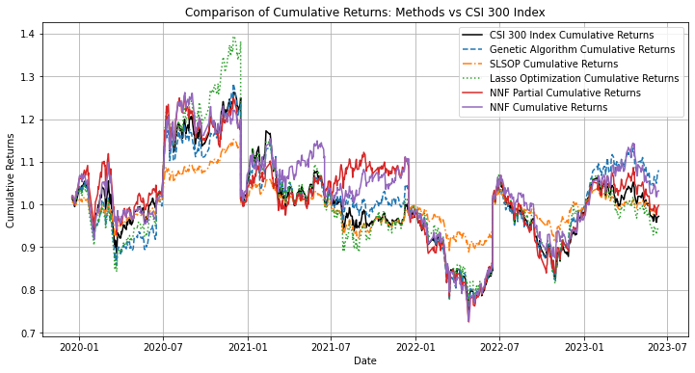
Models Comparison
Reference: “Neural network with fixed noise for index-tracking portfolio optimization”

Slide 13
Benchmark Comparison—— Tracking Error and Market Beta
Periods(YYYYMMDD) |  | 20191217 - 20200616 | 20200617 - 20201216 | 20201217 - 20210616 | 20210617 - 20211216 | 20211217 - 20220616 | 20220617 - 20221216 | 20221219 - 20230611 | Mean | Max | Min | Max-Min
Methods | Benchmark
GA | Tracking Error | 0.33% | 0.45% | 0.46% | 0.44% | 0.33% | 0.32% | 0.34% | 0.38% | 0.46% | 0.32% | 0.14%
Lasso |  | 0.33% | 0.37% | 0.42% | 0.55% | 0.42% | 0.41% | 0.29% | 0.40% | 0.55% | 0.29% | 0.26%
NNF |  | 0.47% | 0.45% | 0.57% | 0.50% | 0.43% | 0.48% | 0.54% | 0.49% | 0.57% | 0.43% | 0.14%
NNF_Partial |  | 0.50% | 0.56% | 0.62% | 0.65% | 0.51% | 0.50% | 0.38% | 0.53% | 0.65% | 0.38% | 0.27%
SLSOP |  | 0.84% | 0.79% | 0.82% | 0.54% | 0.74% | 0.57% | 0.46% | 0.68% | 0.84% | 0.46% | 0.38%
GA | Market Beta | 0.96 | 0.97 | 0.85 | 0.82 | 0.98 | 1.02 | 1.04 | 0.95 | 1.04 | 0.82 | 0.21
Lasso |  | 0.99 | 1.02 | 0.99 | 1.18 | 1.08 | 1.18 | 1.04 | 1.07 | 1.18 | 0.99 | 0.19
NNF |  | 0.99 | 0.95 | 0.91 | 0.85 | 1.04 | 0.91 | 1.09 | 0.96 | 1.09 | 0.85 | 0.24
NNF_Partial |  | 1.07 | 0.99 | 0.75 | 0.79 | 1.01 | 1.00 | 1.12 | 0.96 | 1.12 | 0.75 | 0.37
SLSOP |  | 0.46 | 0.43 | 0.40 | 0.58 | 0.51 | 0.53 | 0.49 | 0.49 | 0.58 | 0.40 | 0.17
GA performs best in terms of minimizing tracking error
All methods except SLSOP gets a market beta of about 1 (CSI 300 : commonly used indication of market risk)

Slide 14
Benchmark Comparison—— Annualized Volatility and Max Drawdown (Risk)
periods(YYYYMMDD) |  | 20191217 - 20200616 | 20200617 - 20201216 | 20201217 - 20210616 | 20210617 - 20211216 | 20211217 - 20220616 | 20220617 - 20221216 | 20221219 - 20230611 | Mean | Max | Min | Max-Min
methods | Benchmark
GA | Annualized Volatility | 0.23 | 0.22 | 0.19 | 0.15 | 0.23 | 0.19 | 0.15 | 0.19 | 0.23 | 0.15 | 0.09
Lasso |  | 0.24 | 0.22 | 0.22 | 0.21 | 0.25 | 0.22 | 0.14 | 0.21 | 0.25 | 0.14 | 0.11
NNF |  | 0.24 | 0.21 | 0.21 | 0.15 | 0.24 | 0.18 | 0.17 | 0.20 | 0.24 | 0.15 | 0.09
NNF_ Partial |  | 0.26 | 0.23 | 0.18 | 0.16 | 0.24 | 0.20 | 0.16 | 0.20 | 0.26 | 0.16 | 0.11
SLSOP |  | 0.11 | 0.10 | 0.09 | 0.11 | 0.12 | 0.10 | 0.07 | 0.10 | 0.12 | 0.07 | 0.05
GA | Max Drawdown | 18.44% | 7.60% | 13.03% | 6.42% | 23.85% | 21.14% | 7.74% | 14.03% | 23.85% | 6.42% | 17.43%
Lasso |  | 19.30% | 6.82% | 13.04% | 13.27% | 22.63% | 23.98% | 13.17% | 16.03% | 23.98% | 6.82% | 17.16%
NNF |  | 14.19% | 7.99% | 10.76% | 5.84% | 26.57% | 18.19% | 11.00% | 13.51% | 26.57% | 5.84% | 20.73%
NNF_ Partial |  | 16.93% | 9.61% | 11.51% | 5.32% | 26.43% | 21.40% | 10.24% | 14.49% | 26.43% | 5.32% | 21.10%
SLSOP |  | 8.98% | 2.93% | 5.81% | 8.83% | 10.96% | 11.67% | 5.93% | 7.87% | 11.67% | 2.93% | 8.74%
All methods except SLSOP perform well in getting a moderate risk

Slide 15
Benchmark Comparison—— Sharpe Ratio and Sortino Ratio (risk-adjusted returns)
periods(YYYYMMDD) |  | 20191217 - 20200616 | 20200617 - 20201216 | 20201217 - 20210616 | 20210617 - 20211216 | 20211217 - 20220616 | 20220617 - 20221216 | 20221219 - 20230611 | Mean | Max | Min | Max-Min
methods | Benchmark
GA | Sharpe Ratio | 0.23 | 0.22 | 0.19 | 0.15 | 0.23 | 0.19 | 0.15 | 0.19 | 0.23 | 0.15 | 0.09
Lasso |  | 0.24 | 0.22 | 0.22 | 0.21 | 0.25 | 0.22 | 0.14 | 0.21 | 0.25 | 0.14 | 0.11
NNF |  | 0.24 | 0.21 | 0.21 | 0.15 | 0.24 | 0.18 | 0.17 | 0.20 | 0.24 | 0.15 | 0.09
NNF_ Partial |  | 0.26 | 0.23 | 0.18 | 0.16 | 0.24 | 0.20 | 0.16 | 0.20 | 0.26 | 0.16 | 0.11
 |  | 0.11 | 0.10 | 0.09 | 0.11 | 0.12 | 0.10 | 0.07 | 0.10 | 0.12 | 0.07 | 0.05
SLSOP
GA | Sortino Ratio | 0.18 | 0.08 | 0.13 | 0.06 | 0.24 | 0.21 | 0.08 | 0.14 | 0.24 | 0.06 | 0.17
Lasso |  | 0.19 | 0.07 | 0.13 | 0.13 | 0.23 | 0.24 | 0.13 | 0.16 | 0.24 | 0.07 | 0.17
NNF |  | 0.14 | 0.08 | 0.11 | 0.06 | 0.27 | 0.18 | 0.11 | 0.14 | 0.27 | 0.06 | 0.21
NNF_ Partial |  | 0.17 | 0.10 | 0.12 | 0.05 | 0.26 | 0.21 | 0.10 | 0.14 | 0.26 | 0.05 | 0.21
SLSOP |  | 0.09 | 0.03 | 0.06 | 0.09 | 0.11 | 0.12 | 0.06 | 0.08 | 0.12 | 0.03 | 0.09
All modern methods get a higher risk-adjusted return compared with SLSOP
As well concerning more about downside risk

Slide 16
Benchmark Comparison—— Cumulative Return (pure return)
periods(YYYYMMDD) |  | 20191217 - 20200616 | 20200617 - 20201216 | 20201217 - 20210616 | 20210617 - 20211216 | 20211217 - 20220616 | 20220617 - 20221216 | 20221219 - 20230611 | Mean | Max | Min | Max-Min
methods | Benchmark
GA | Cumulative Return | -7.16% | 23.75% | 2.10% | 2.92% | -13.86% | -3.64% | 8.03% | 1.73% | 23.75% | -13.86% | 37.61%
Lasso |  | -3.70% | 38.17% | 2.78% | -1.10% | -13.14% | -1.40% | -5.45% | 2.31% | 38.17% | -13.14% | 51.31%
NNF |  | -1.41% | 20.06% | 11.28% | 9.23% | -13.93% | -6.58% | 3.18% | 3.12% | 20.06% | -13.93% | 33.99%
NNF_ Partial |  | 4.45% | 19.30% | 3.60% | 7.88% | -12.63% | -5.68% | -0.17% | 2.39% | 19.30% | -12.63% | 31.93%
SLSOP |  | -1.61% | 14.87% | 0.58% | -2.43% | -5.93% | 0.26% | -1.54% | 0.60% | 14.87% | -5.93% | 20.79%
If you do expected a rise of CSI 300,
Getting a higher average cumulative return
More return in cases CSI 300 do perform well
If you do expected a drop of CSI 300,
Go with related options and futures

Slide 17
Conclusion (Pros and Cons)
Our perspective when carrying out the project
members of a fund management company to optimize a Index fund product
Target for tracking the index in minimizing tracking error
Products for index investing consumers expecting either a bull or bear stock index trend (direct trade of CSI index: infeasible)
Comparison of the performance of different methods we learned
Our limits
Fixed training periods and back test periods
(promised availability of stock price data) →more flexibility as the market are always changing
GA model performs best in this case, what if other indices
Concerning the difference of replacement announcement and actual execution

Slide 18
Reference
Yang, T., & Huang, X. (2022). Two new mean–variance enhanced index tracking models based on uncertainty theory. The North American Journal of Economics and Finance, 59, 101622. doi:10.1016/j.najef.2021.101622
Ruiz-Torrubiano, R., & Suárez, A. (2009). A hybrid optimization approach to index tracking. Annals of Operations Research, 166(1), 57-71. doi:10.1007/s10479-008-0404-4
Adams, J., Hayunga, D., & Mansi, S. (2022). Index fund trading costs are inversely related to fund and family size. Journal of Banking &amp; Finance, 140, 106527. doi:10.1016/j.jbankfin.2022.106527
Chu, G., Goodell, J. W., Li, X., & Zhang, Y. (2021). Long-term impacts of index reconstitutions: Evidence from the CSI 300 additions and deletions. Pacific-Basin Finance Journal, 69, 101651. doi:10.1016/j.pacfin.2021.101651
Fang Liu, & Wen Wen. (2023). Stock index constituent adjustments and corporate social responsibility: Evidence from a quasi-natural experiment of CSI 300 index adjustments. China Journal of Accounting Studies, 11(2), 1-32. doi:10.1080/21697213.2023.2239662

Slide 19
Thank you!
Team 9
Ziyuan Zhang
Zhitong Ye
Yang Xia
Weichen Zhu
Yingzi Li
12/7/2023

